Slide 1

Project : Data Insight & AutoML
Mansi| University Roll No.: 2302610
Guru Nanak Dev Engineering College, Ludhiana
Training Organization: Sensation software solution Pvt. Ltd.
Duration: 23rd June 2025 – 23rd July 2025

Slide 2
Project Objective : From Raw Data to Model Comparison
A presentation on leveraging Automated Machine Learning (AutoML) for efficient data processing, insightful model building, and comprehensive performance comparison.

Slide 3



Introduction: Why Automate Machine Learning?
Accelerated Workflow
Efficient Evaluation
Actionable Insights
AutoML simplifies complex ML pipelines, drastically reducing the time required for model building and experimentation.
Our project uses AutoML to quickly process data and systematically evaluate multiple algorithms to find the best fit.
The core goal is to deliver clear, data-driven insights by comparing model accuracies on rigorously cleaned data.

Slide 4

Step 1: Dataset Overview & Challenges
Initial Data State
The raw dataset contained significant amounts of missing or null values (NaN) across multiple columns.
Null values, if unaddressed, can introduce bias, leading to inaccurate model training and unreliable predictions.
We faced a diverse mix of categorical and numerical features requiring careful, tailored preprocessing.

Slide 5




Step 2: Data Preprocessing – Handling Missing Values
We implemented robust null value detection and removal/imputation strategies:
Detection
Systematic identification of all null entries across the entire feature space.
Imputation/Removal
Application of techniques like mean/median imputation for numerical data or elimination of rows/columns where appropriate.
Validation
The result is a high-quality, normalized dataset, substantially improving the reliability and readiness for subsequent modeling steps.

Slide 6





Step 3: Applying Multiple Machine Learning Models
AutoML was instrumental in rapidly deploying and testing a suite of diverse machine learning algorithms.
Logistic Regression
Random Forest
Simple, foundational model for classification, providing a baseline performance metric.
Ensemble method known for high accuracy and robustness against overfitting.
Support Vector Machine (SVM)
Decision Tree
Effective in high-dimensional spaces, using kernel tricks for complex boundary separation.
Uses flowchart like structure of hierarchical model based on data features to predict outcomes
AutoML automates essential steps like feature engineering and hyperparameter tuning, enabling rapid, comprehensive experimentation.

Slide 7
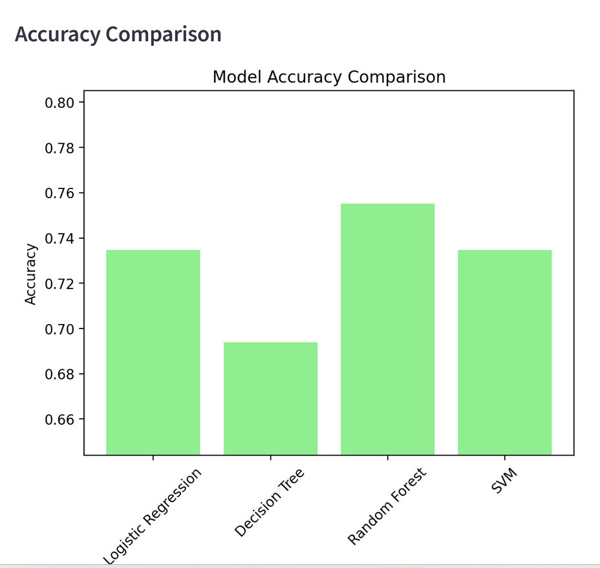
Step 4: Model Accuracy Results on Test Data
The bar chart clearly visualizes the variance in performance, indicating superior performance from the more complex ensemble methods.

Slide 8



Challenges & Critical Considerations
The "Black Box" Effect
Garbage In, Garbage Out
Interpretability vs. Accuracy
While efficient, AutoML can obscure the internal workings of the final model. Human oversight and understanding of model internals remain crucial.
AutoML cannot overcome fundamental flaws in the input data. Data quality and rigorous cleaning remain the most critical success factors.
Often, the most accurate models (like Gradient Boosting) are less interpretable. We must balance high accuracy with the need for explaining predictions based on the specific use case.

Slide 9



Conclusion & Future Directions
The project successfully utilized AutoML to streamline the workflow from raw data ingestion to comparative model evaluation.
1
2
3
Core Success
Next Steps
The Vision
AutoML facilitated efficient data processing and led to the identification of the optimal model (Gradient Boosting) for this dataset.
We will now focus on deploying the best-performing model and integrating it with real-time data pipelines for continuous prediction.
Leveraging AutoML is key to unlocking deeper data insights and enabling smarter, faster, and more robust organizational decisions.

